Slide 1
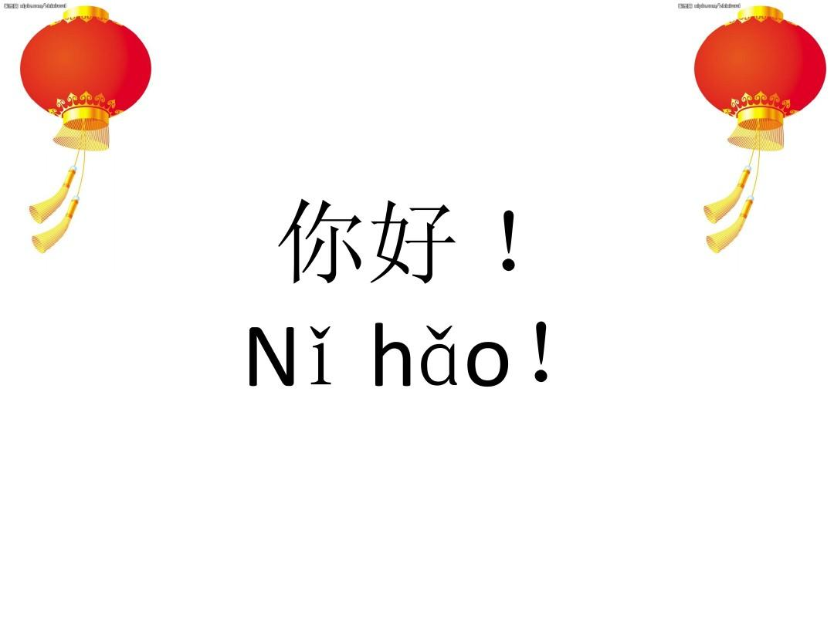

Slide 2
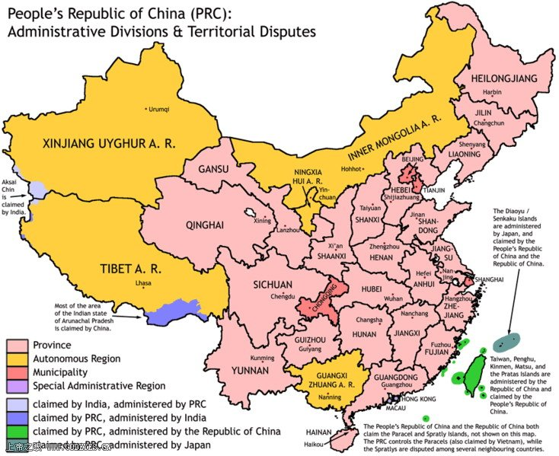
Provinces & Administrative Divisions
23
5
4
2
14

Slide 3
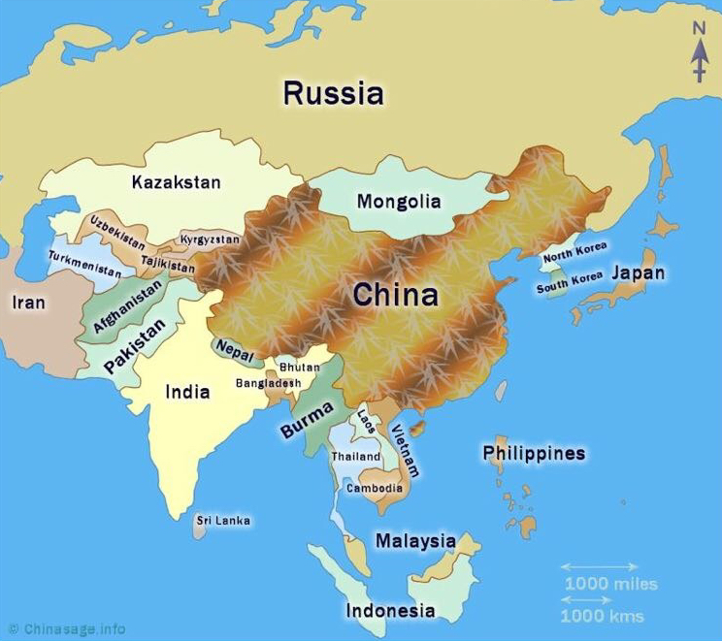
China Map & Neighboring Countries
13

Slide 4

How should you Call me?
Lǎo shī老 师

Slide 5
Self-introduction
What’s your name?
Nǐ jiào shén me míng zì ？
My name is + name.
Wǒ jiào + name.
what
name
to call,
to be called

Slide 6
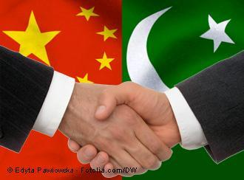
China & Pakistan Relationship
26

Slide 7
Introduction of China
Q:What is complete name of China?
A: The People’s Republic of China
Chinese Translation of China:
Zhōng guó
中 国
8

Slide 8
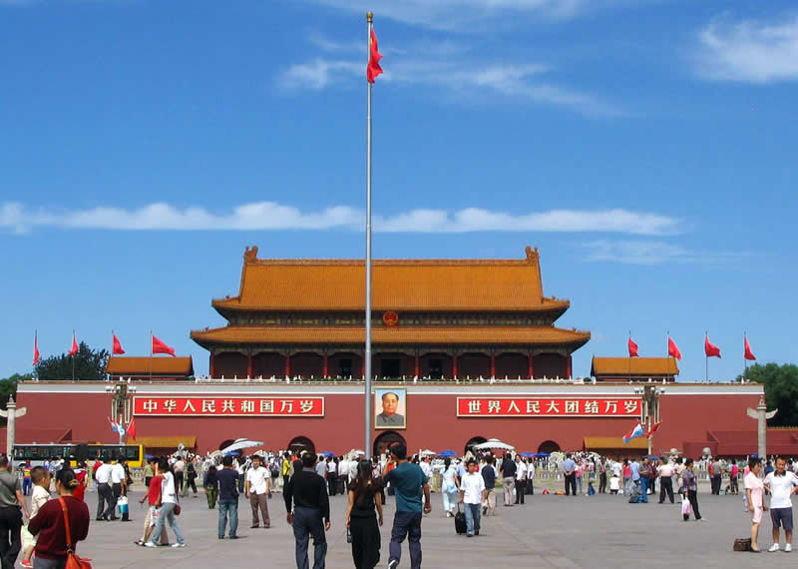
Tian’an Men Square
16

Slide 9
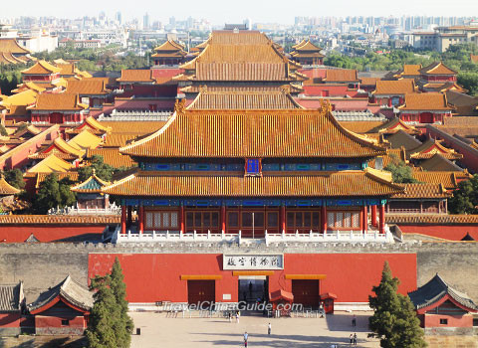
Forbidden City
17

Slide 10
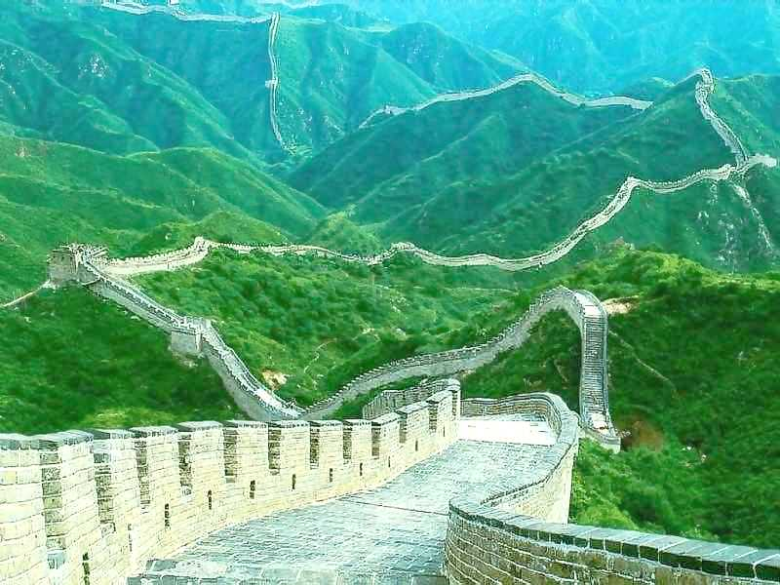
Beijing Great Wall
18

Slide 11
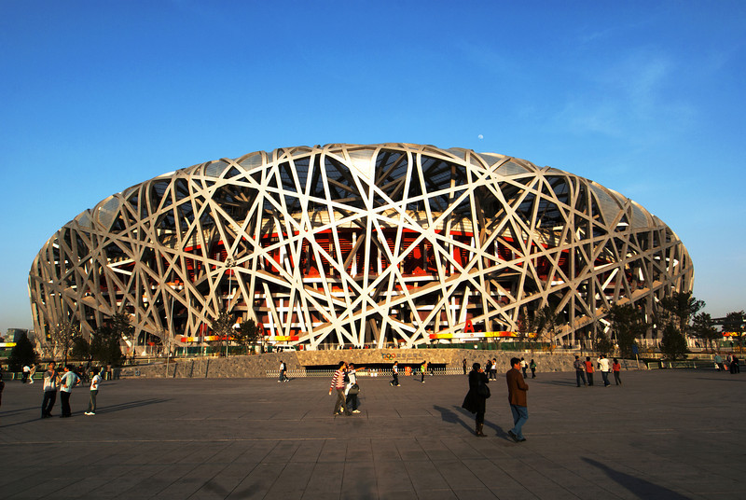
Beijing Olympic Stadium
19

Slide 12
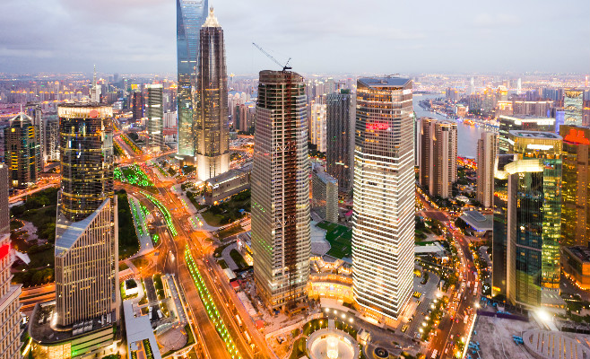
Largest City of China
Shanghai
20

Slide 13
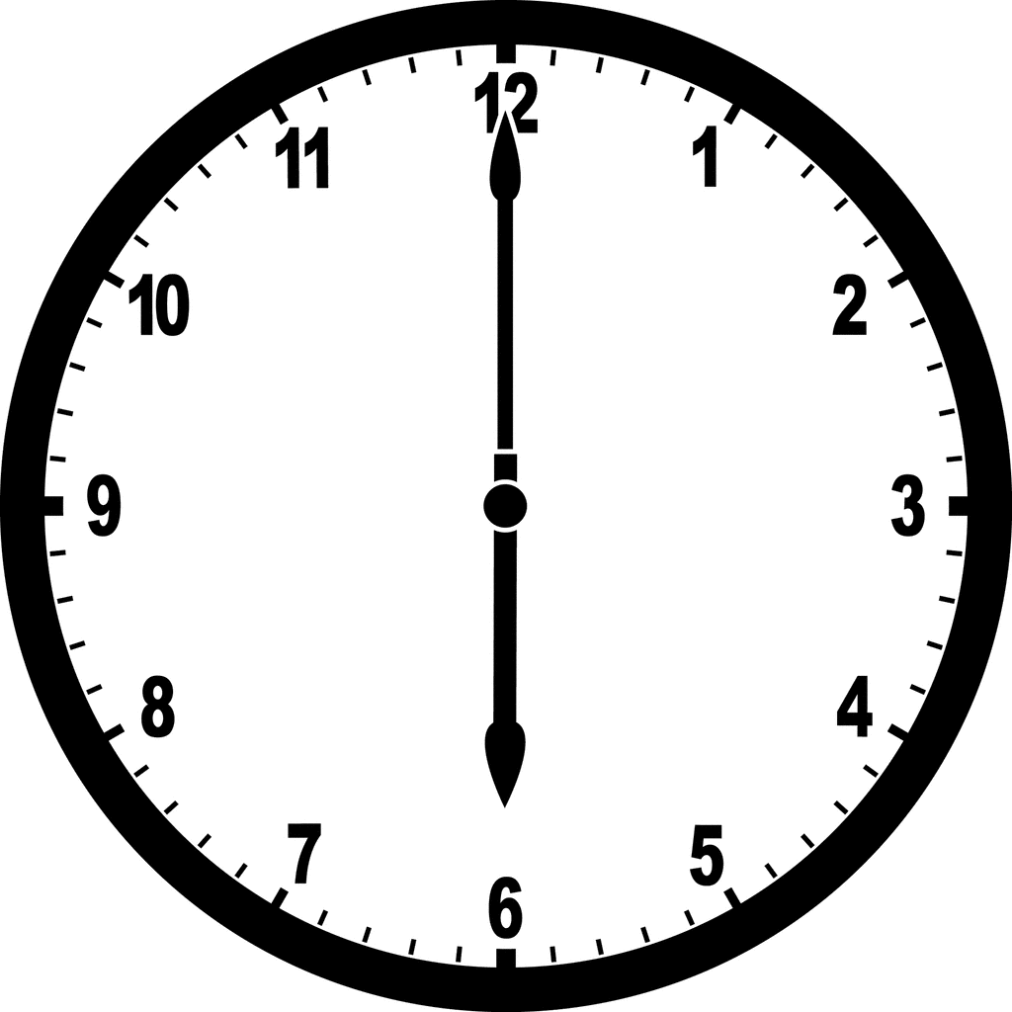
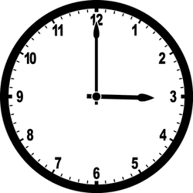
Time Difference between China & Pakistan
China is 3 hours ahead of Pakistan in time
Pakistan
China
25

Slide 14
Chinese Language Basics
History of Language: 4,000 Years old.
Chinese is a pure language.
Chinese have no alphabets rather Chinese have words directly.
27

Slide 15
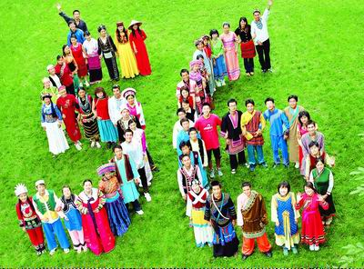
Minorities in China
56 Minorities
23

Slide 16
Base of Chinese Language
Majority in China：Han Nation
Official Language of China: Han Language
Language Translation in Chinese : Yu
Chinese Language : Han Yu
22

Slide 17
Han Yu
Mandarin （Pu Tong Hua）
Chinese Local Languages
Standard Language ( Mandarin is based on the pronunciation of Beijing)

Slide 18
Mandarin(Putong Hua)
Pakistan | China
Standard Language: Urdu | Standard Language: Putong Hua
Punjab: Punjabi | South of China: Cantonese
Sindh: Sindhi | Minorities have their own languages
Khber Phaktonkhawa: Pushto
Balochistan: Balochi
Other Local Languages
28

Slide 19
Goals of the course
Accomplish the level up to HSK 1
Time Frame: 3-4 Months ( 48-54 Hours )
Vocabulary Achieved : (150-300) Words
15 topics of basic daily conversations

Slide 20
Beginner's tool of learning Chinese Language
Pin Yin
Pin Yin is literally the phonetic spelling of the Chinese Language. The system of Phonetic uses the Latin Alphabets( a, b, c…) to write Chinese Characters phonetically.
Chinese Character is the standard form of writing.

Slide 21


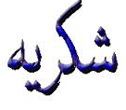
Example
English | Chinese Character | Chinese Pinyin | Urdu character | Urdu Pinyin Way
Hello | 你 好 | Nǐ hǎo |  | Assalamualikum
Bye Bye | 再 见 | Zài jiàn |  | Allah Hafiz
Thank You | 谢 谢 | Xiè xiè |  | Shukria
31

Slide 22
Chinese Characters History
Chinese Characters developed from pictures

Slide 23
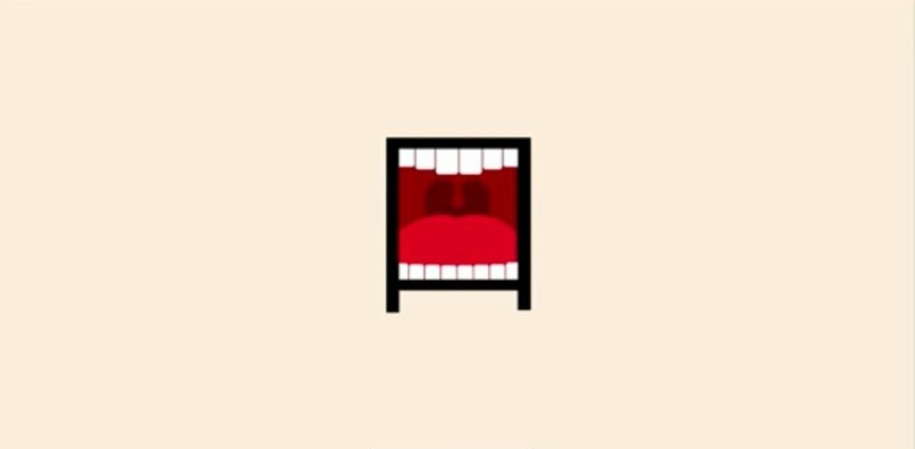

Slide 24
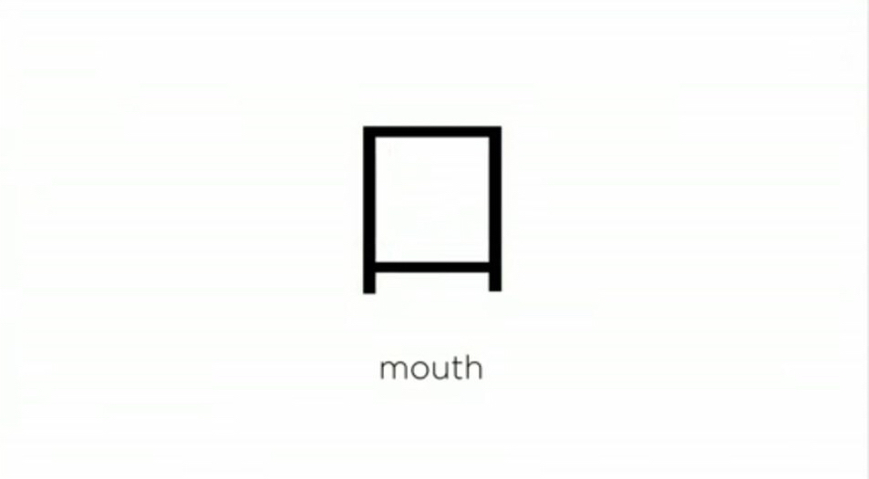

Slide 25
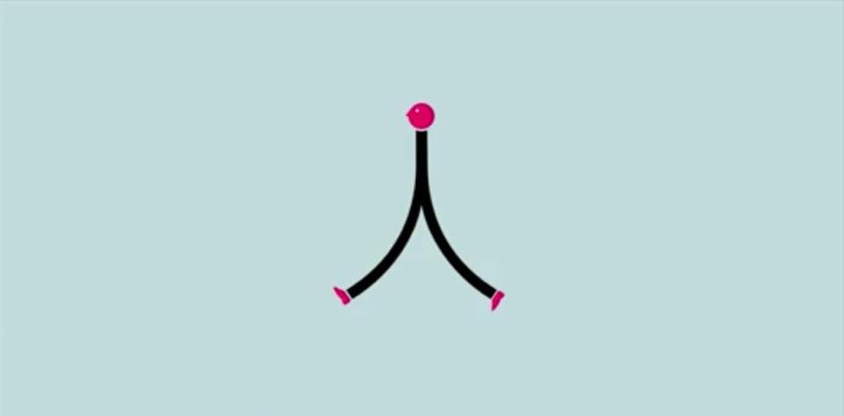

Slide 26


Slide 27


Slide 28
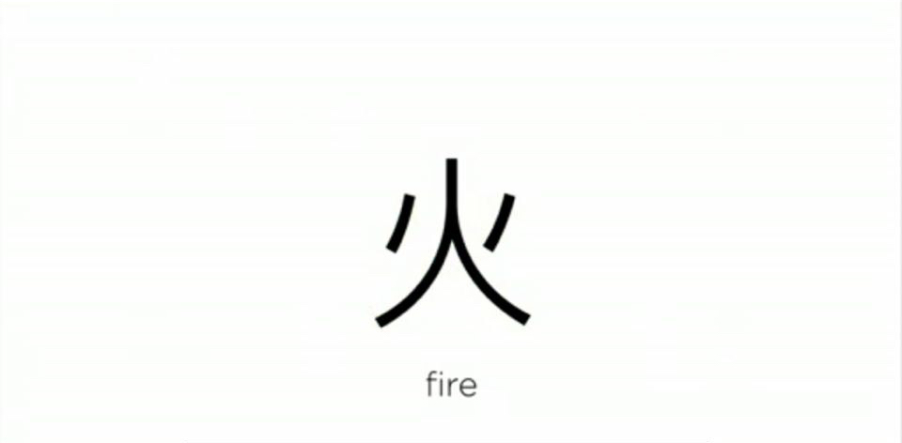

Slide 29
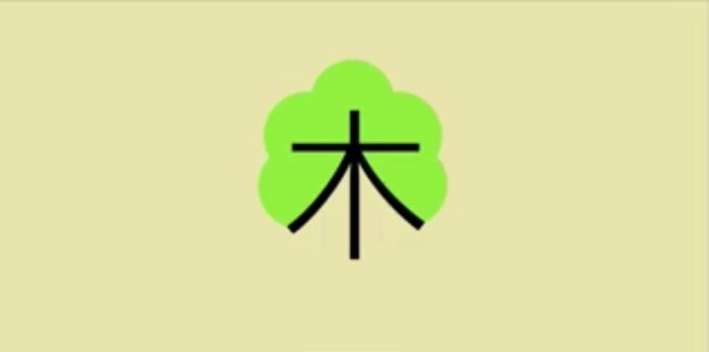

Slide 30
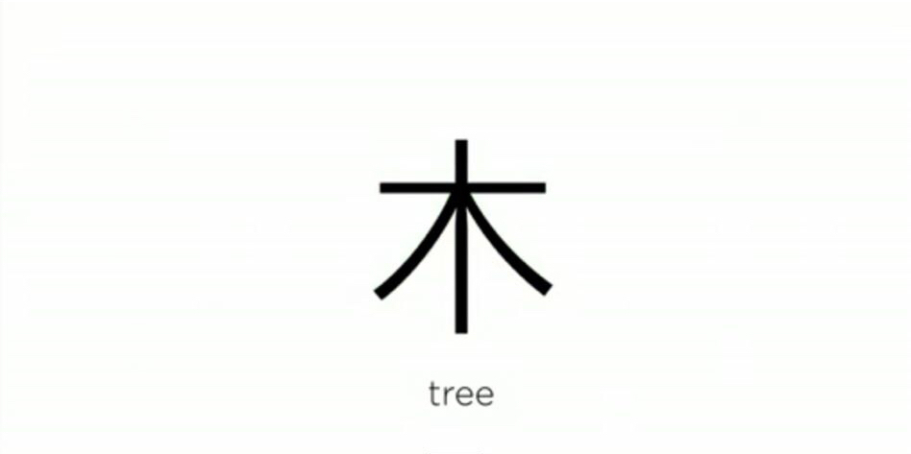

Slide 31
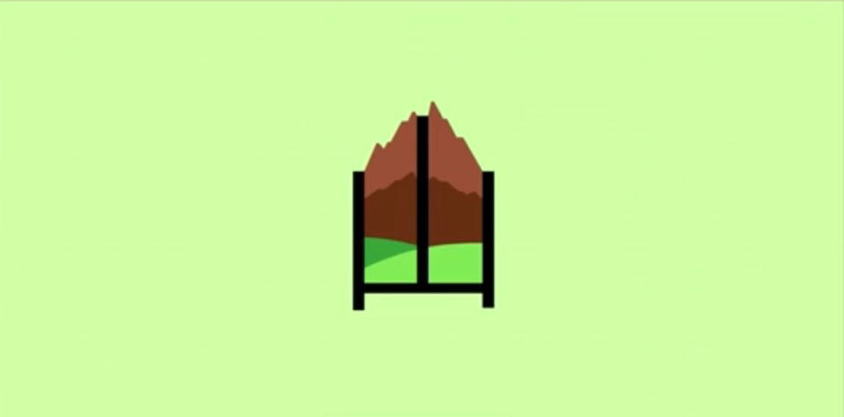

Slide 32
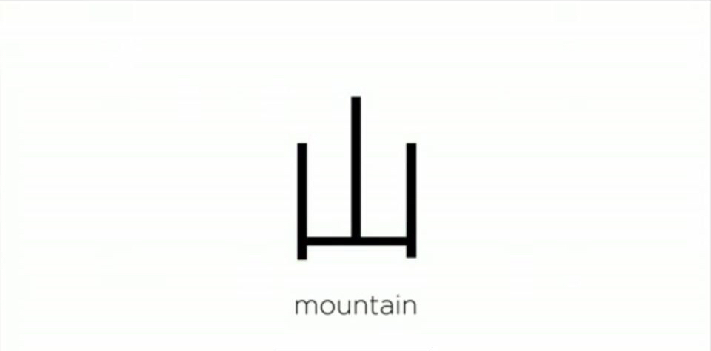

Slide 33


Slide 34
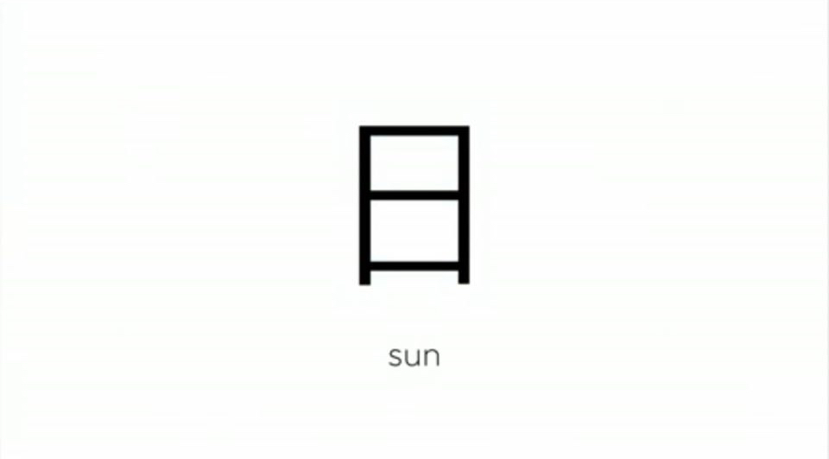

Slide 35


Slide 36
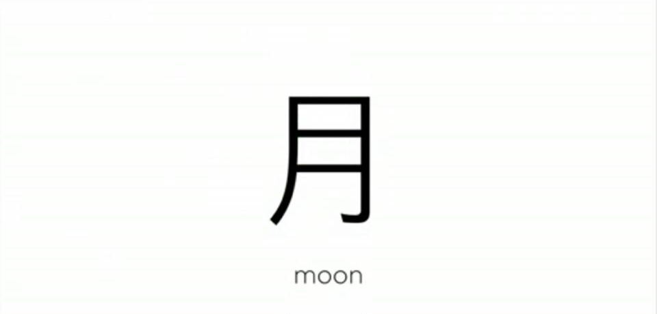

Slide 37
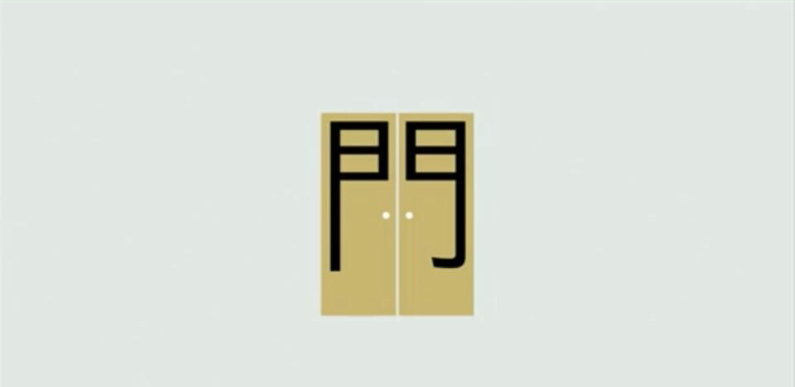

Slide 38


Slide 39
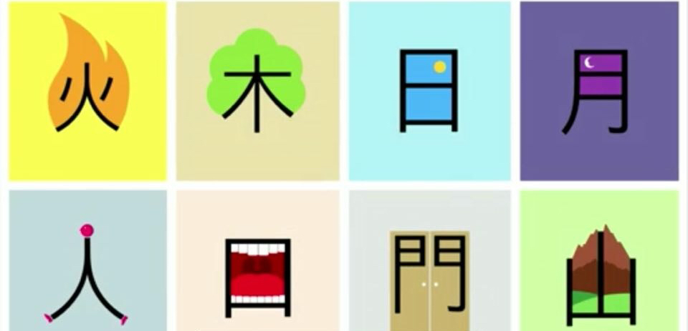

Slide 40
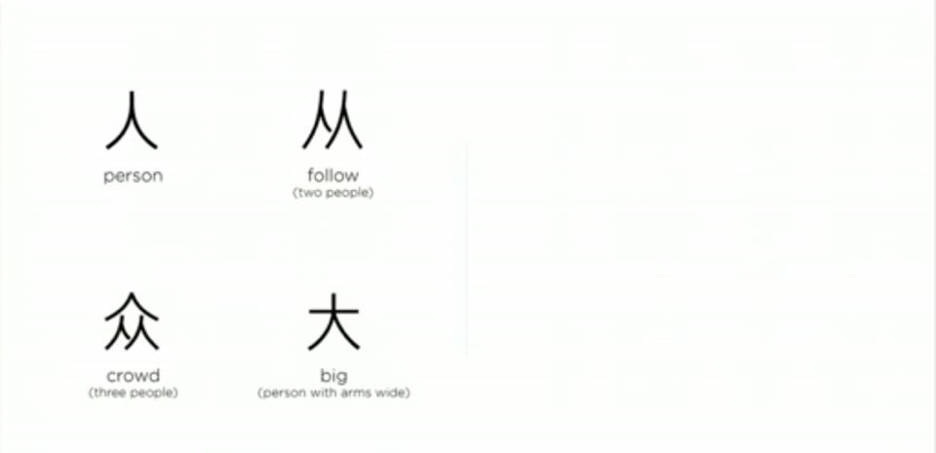

Slide 41
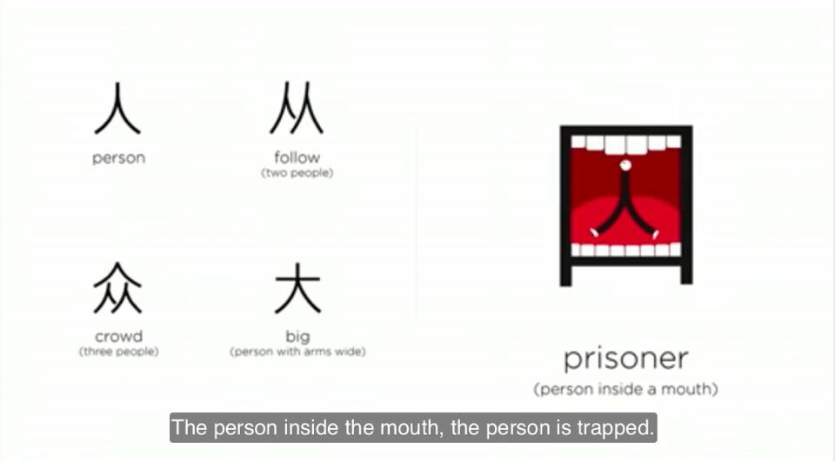

Slide 42
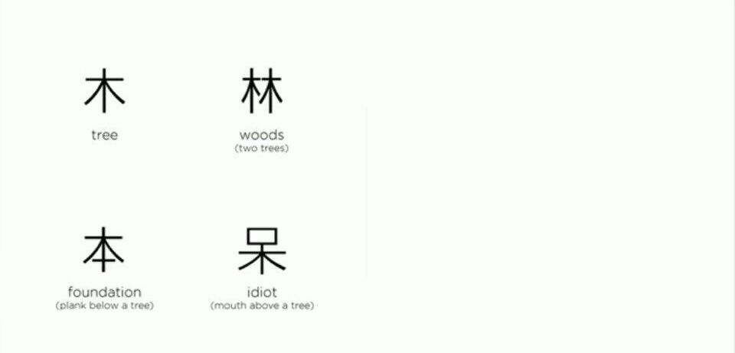

Slide 43
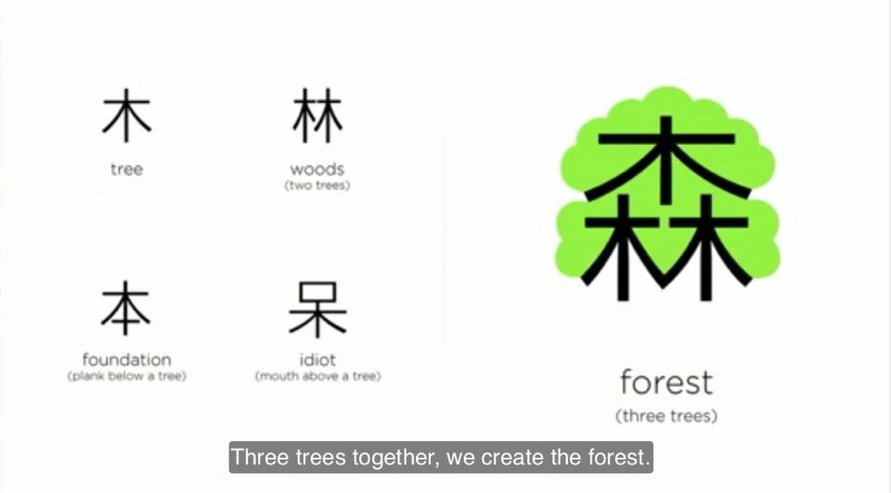

Slide 44
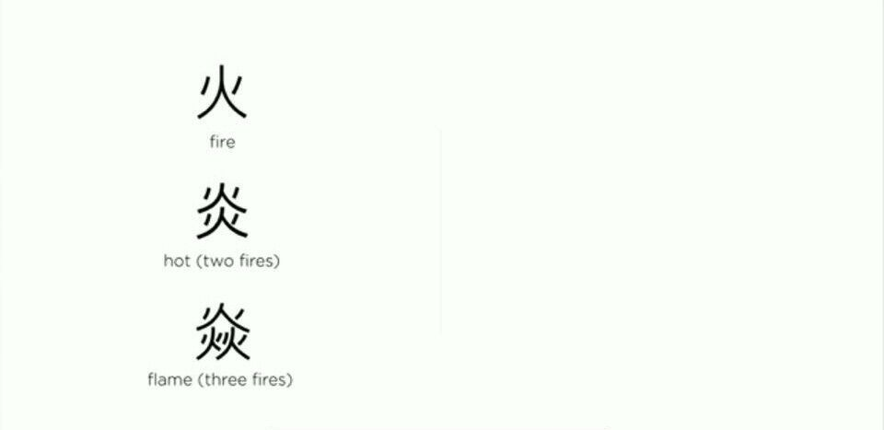

Slide 45
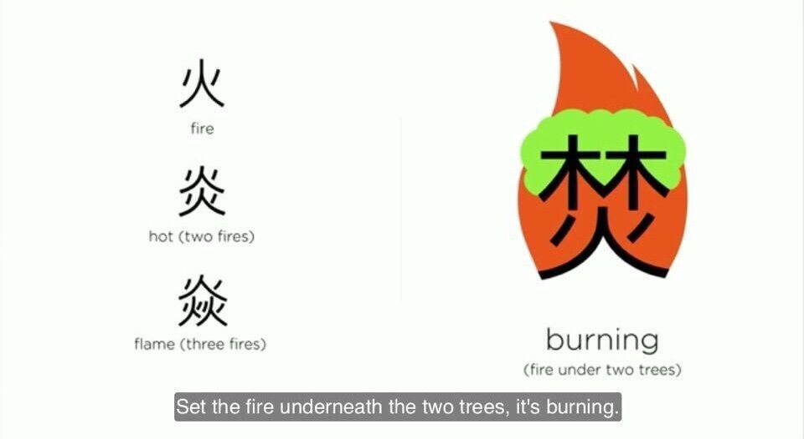

Slide 46
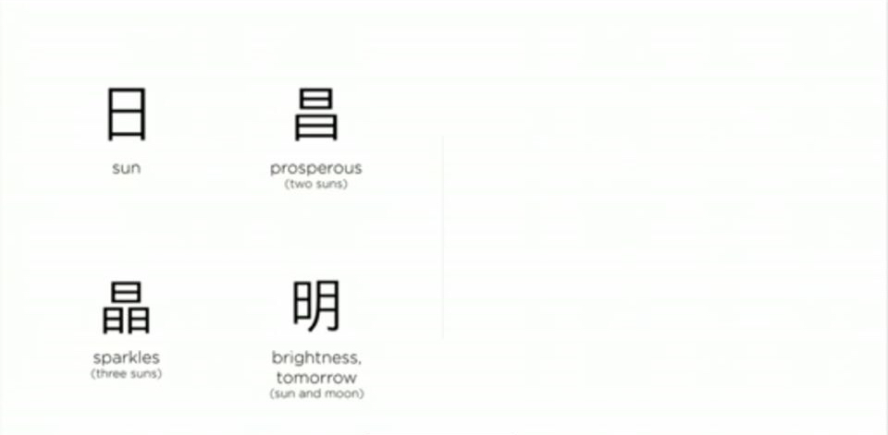

Slide 47
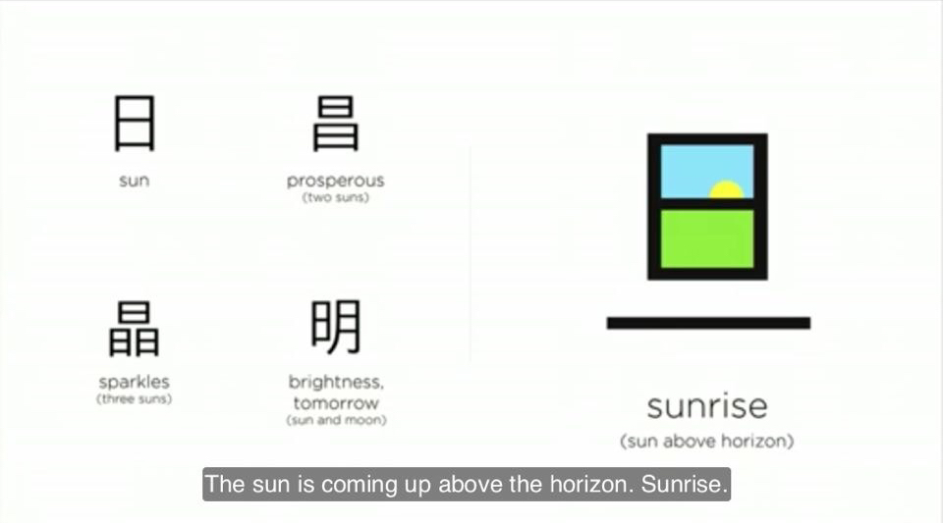

Slide 48
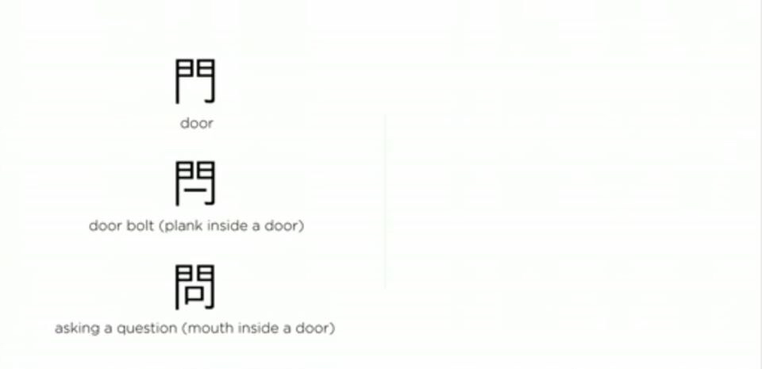

Slide 49
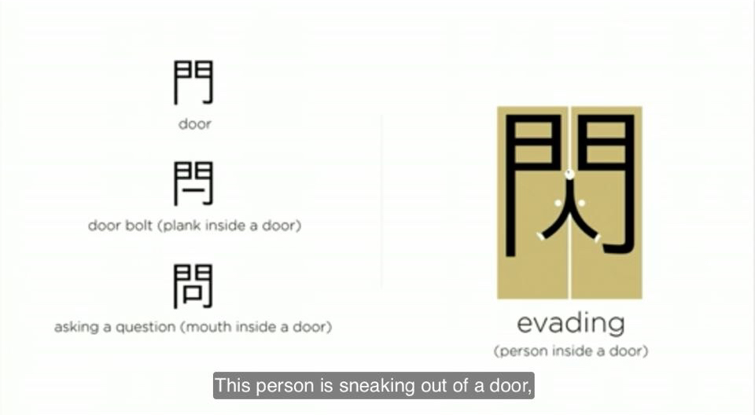

Slide 50
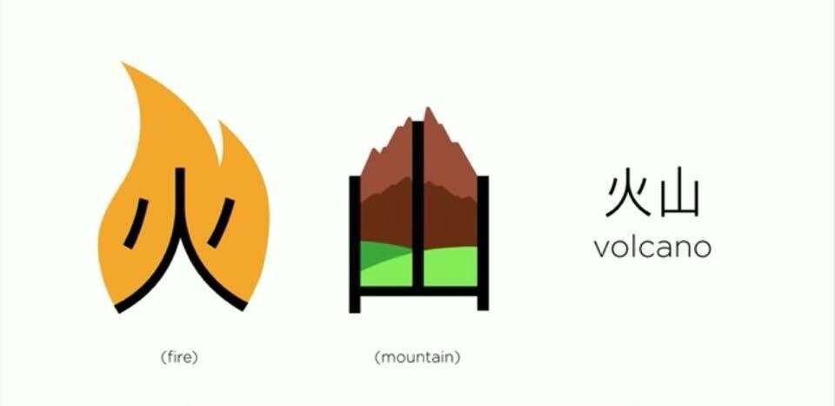

Slide 51
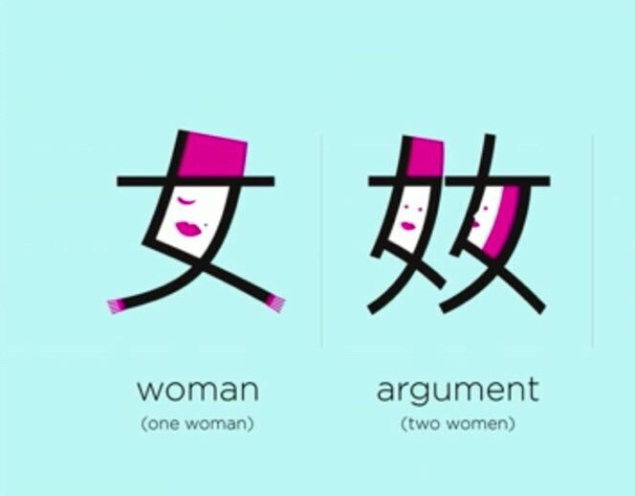

Slide 52
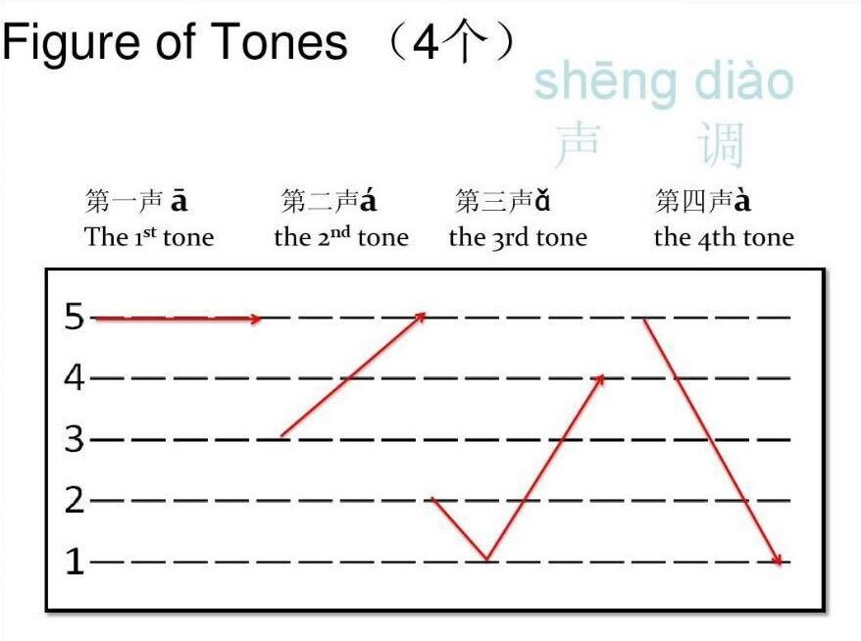

Slide 53
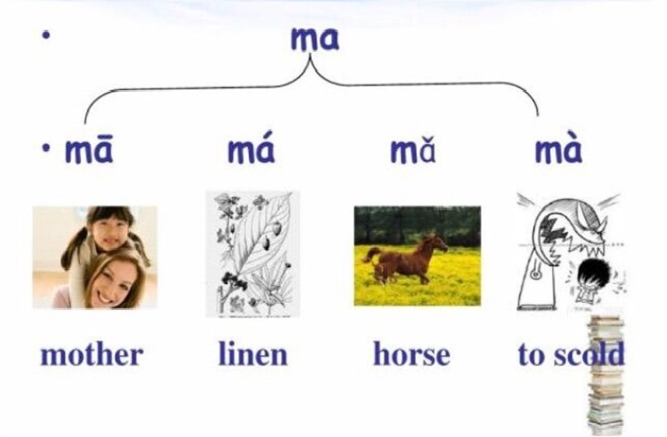

Slide 54
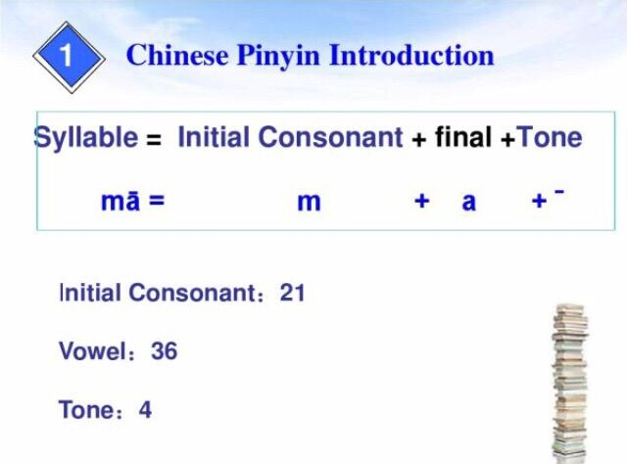

Slide 55
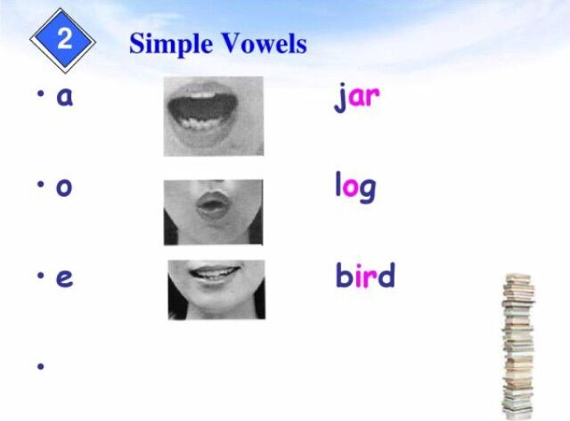

Slide 56
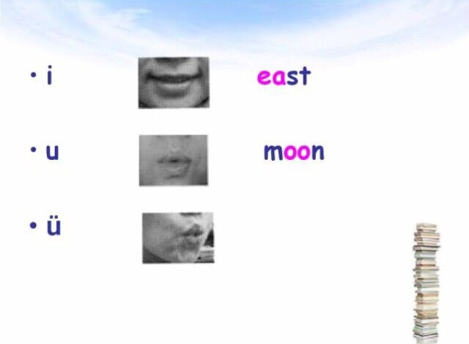

Slide 57

Practice

Slide 58
a o e i u ü

Slide 59
a
ai ao an ang

Slide 60
o
ou ong

Slide 61
e
ei er en eng

Slide 62
i
ia ie in
iao ian
iou(iu) ing
iang iong

Slide 63
u
uo ua
uai uei(ui)
uan uen(un)
uang ueng

Slide 64
ü
üe üan ün

Slide 65
b p m f + o

Slide 66
d t n l g k h + e

Slide 67
j q x + i

Slide 68
zh ch sh r + i
z c s + i

Slide 69
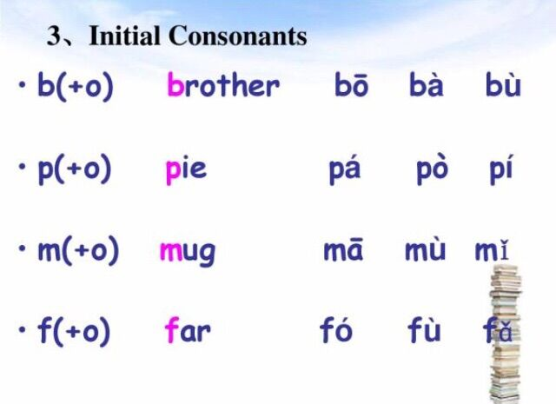

Slide 70
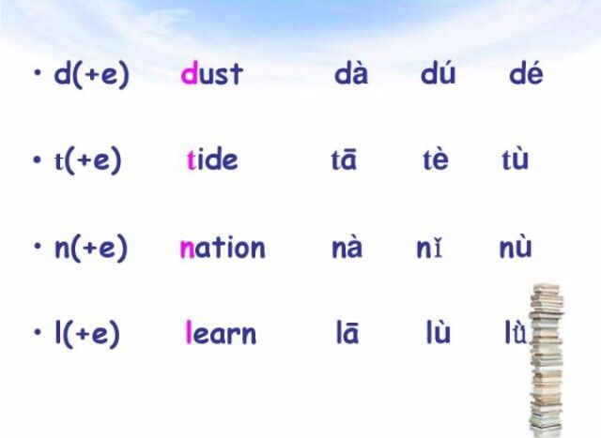

Slide 71


Slide 72
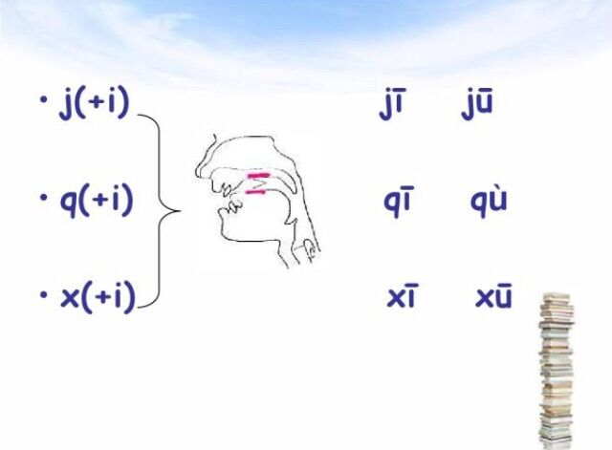

Slide 73
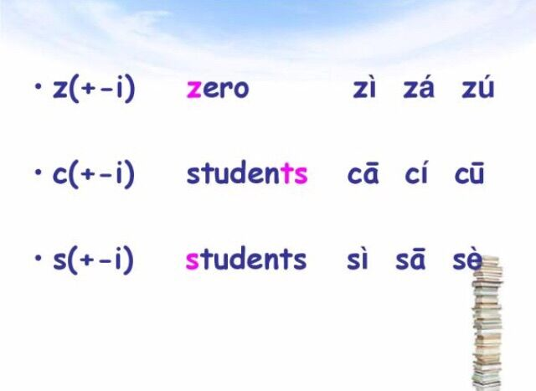

Slide 74
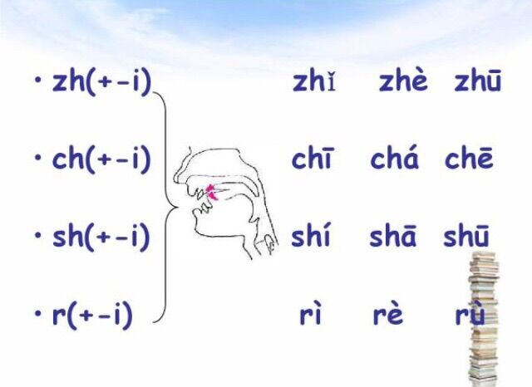

Slide 75
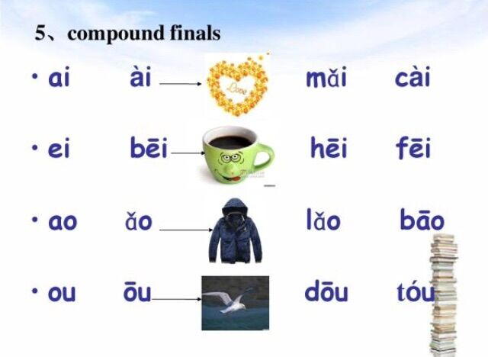

Slide 76
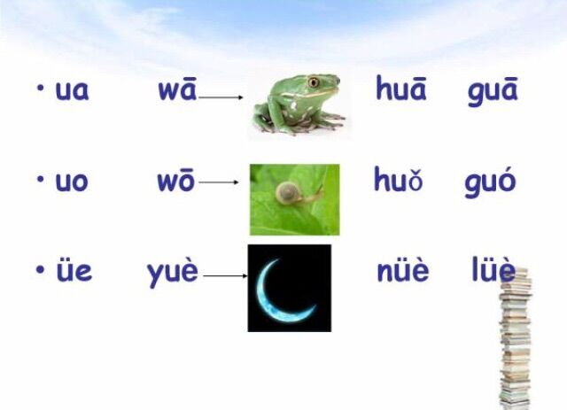

Slide 77
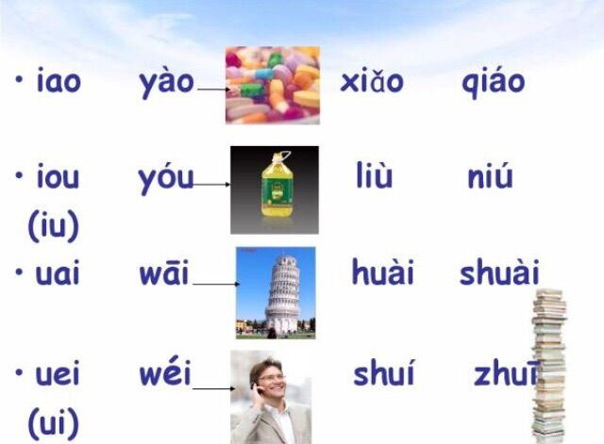

Slide 78


Slide 79


Slide 80


Slide 81


